Slide 1


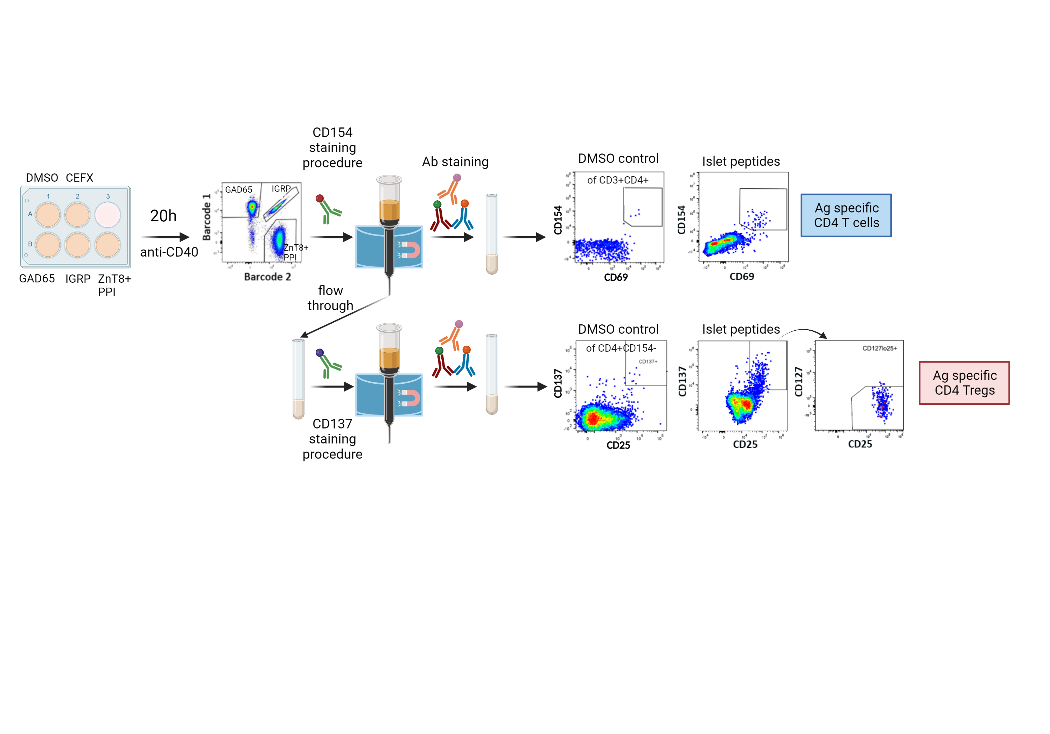
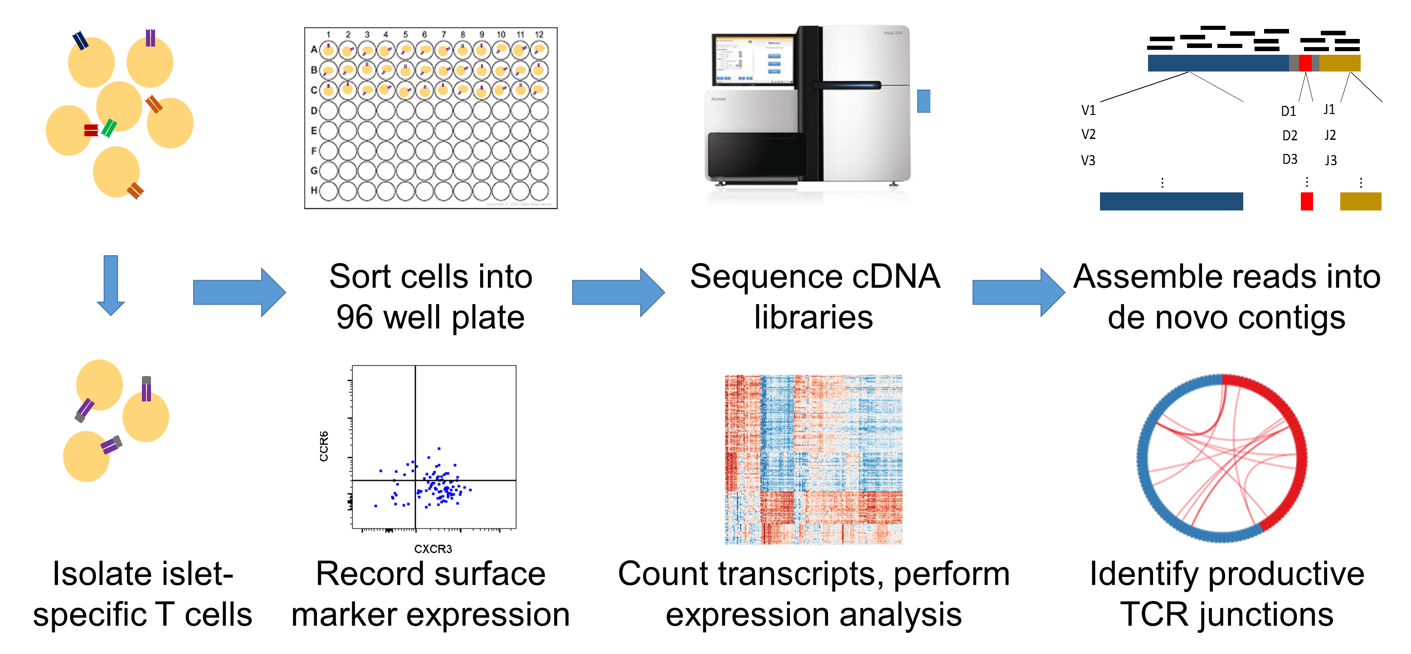
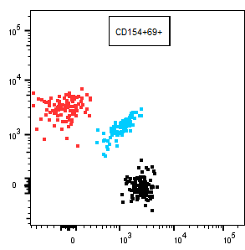
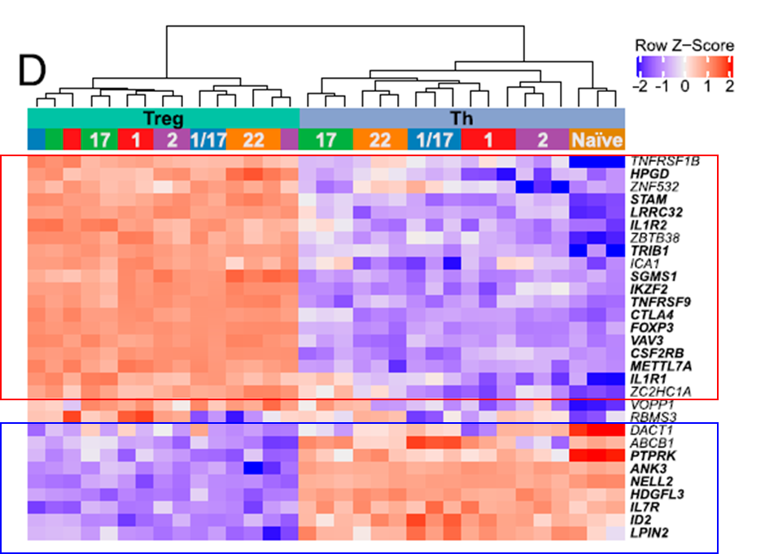
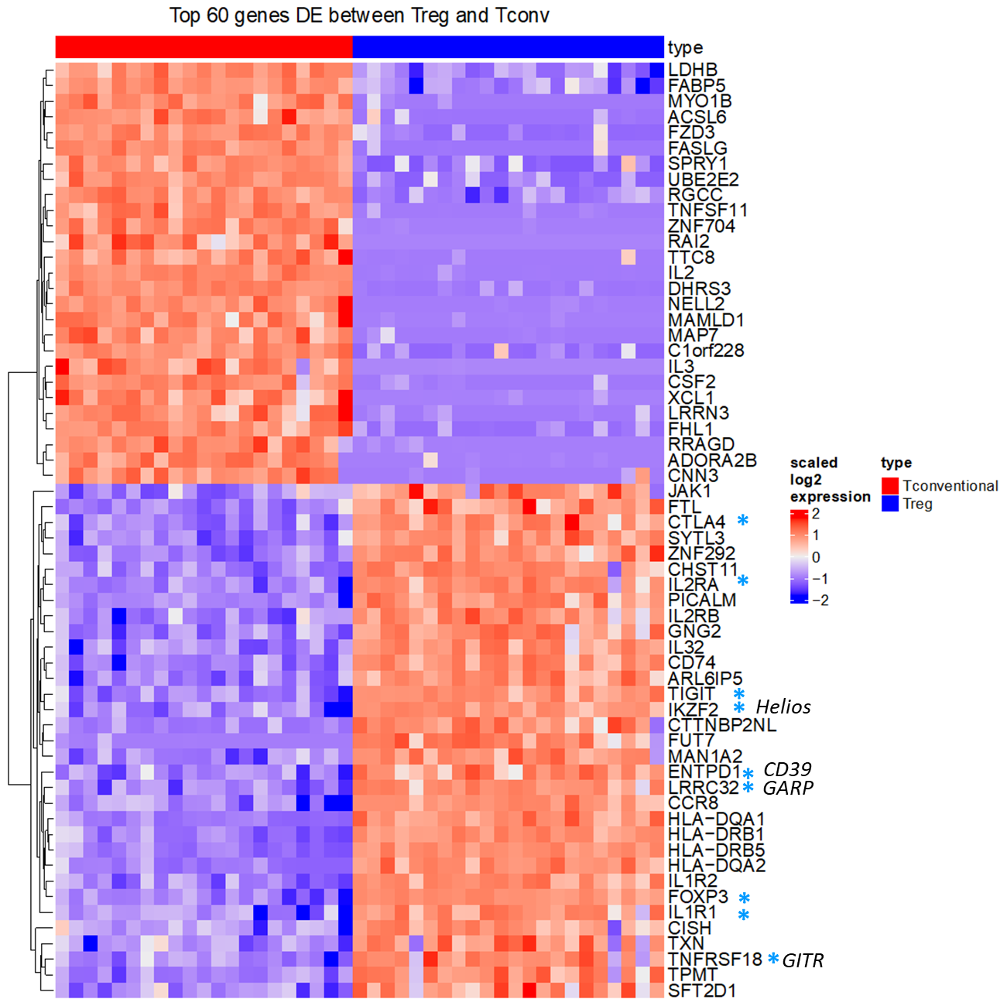
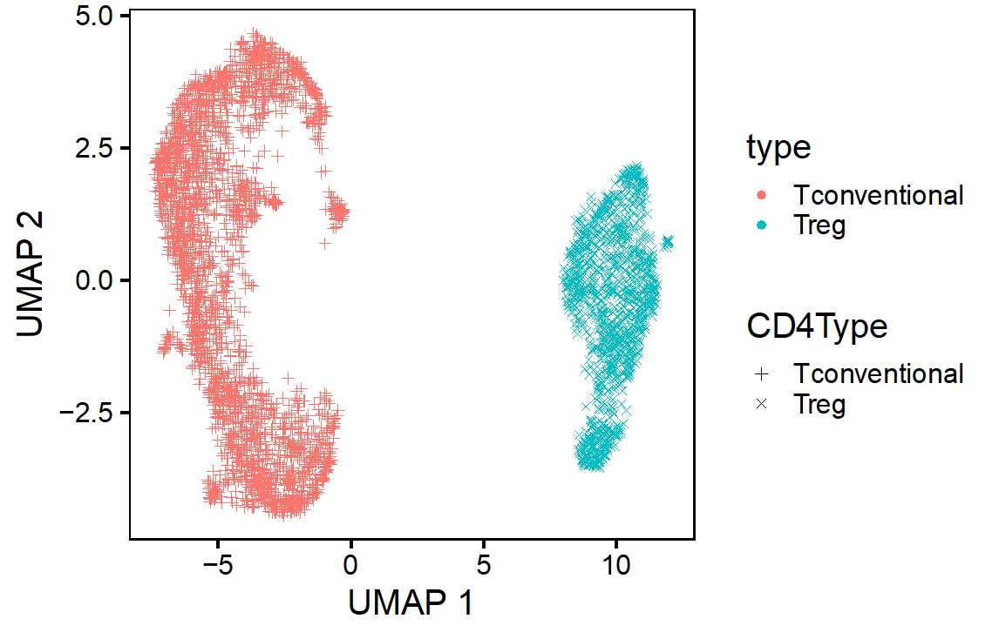
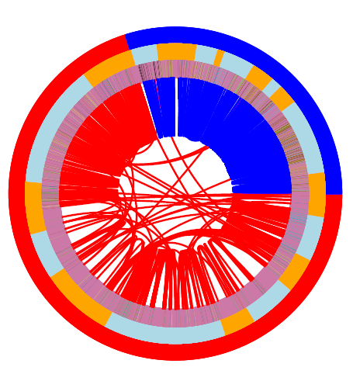
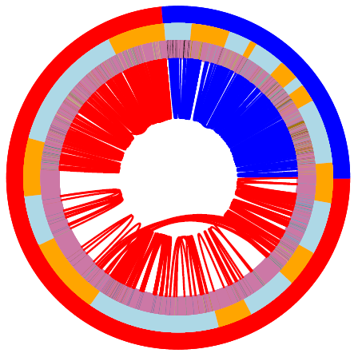
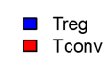
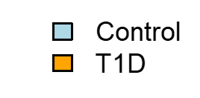
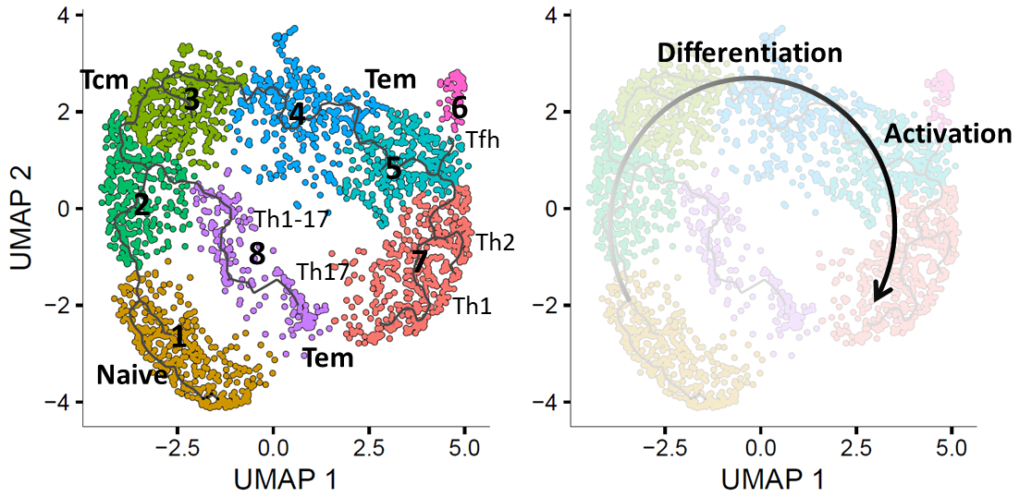
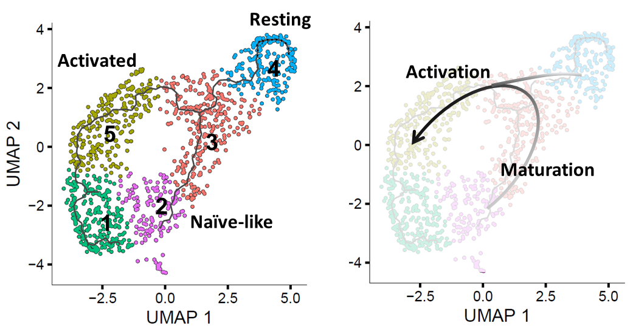
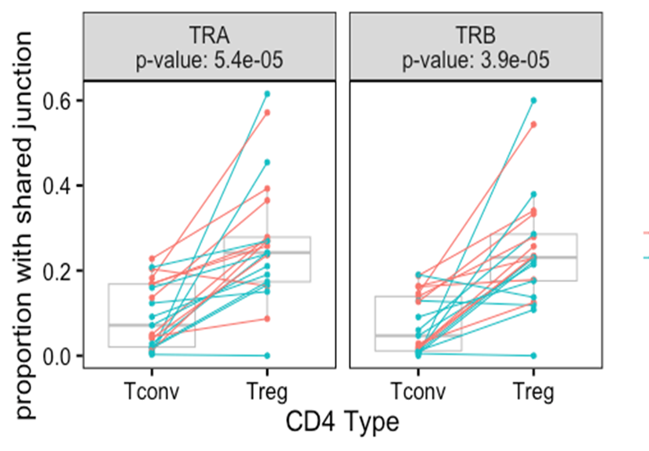
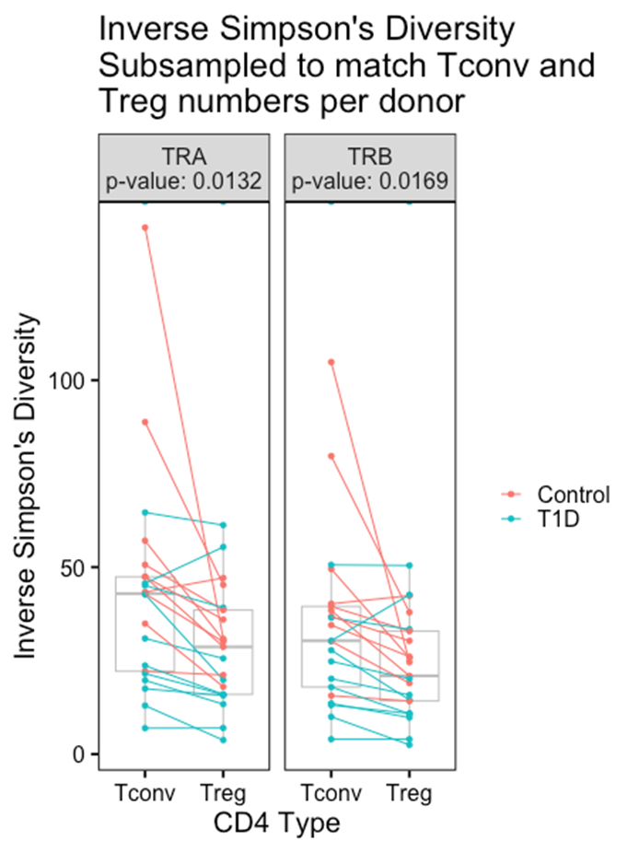
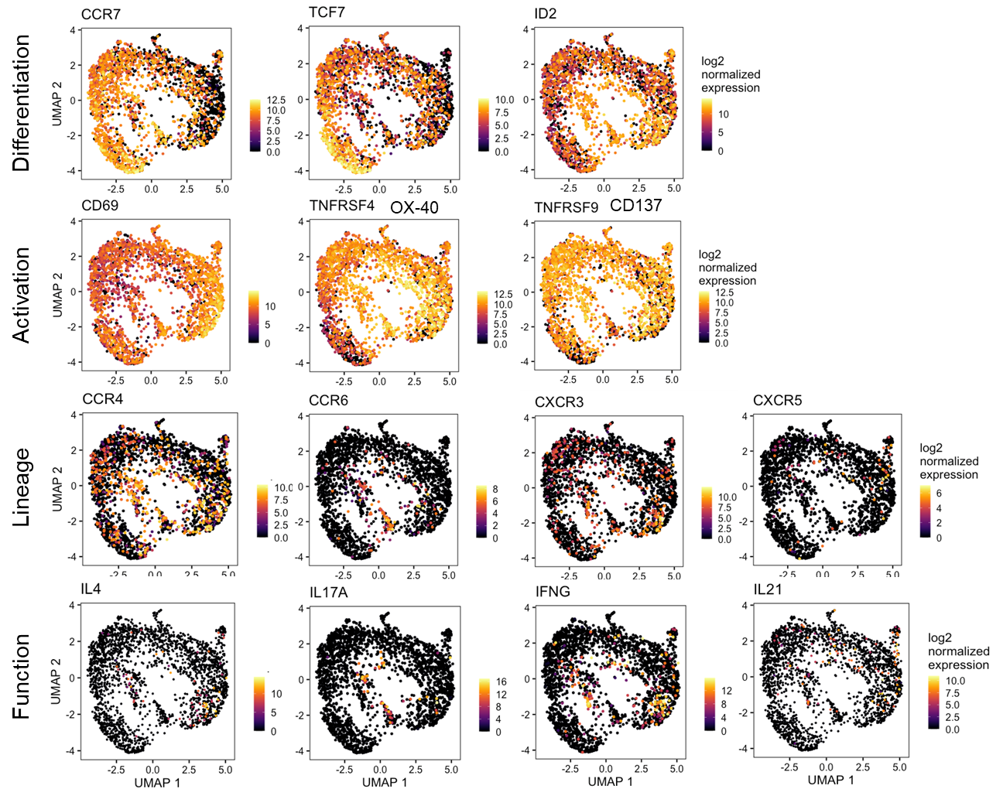
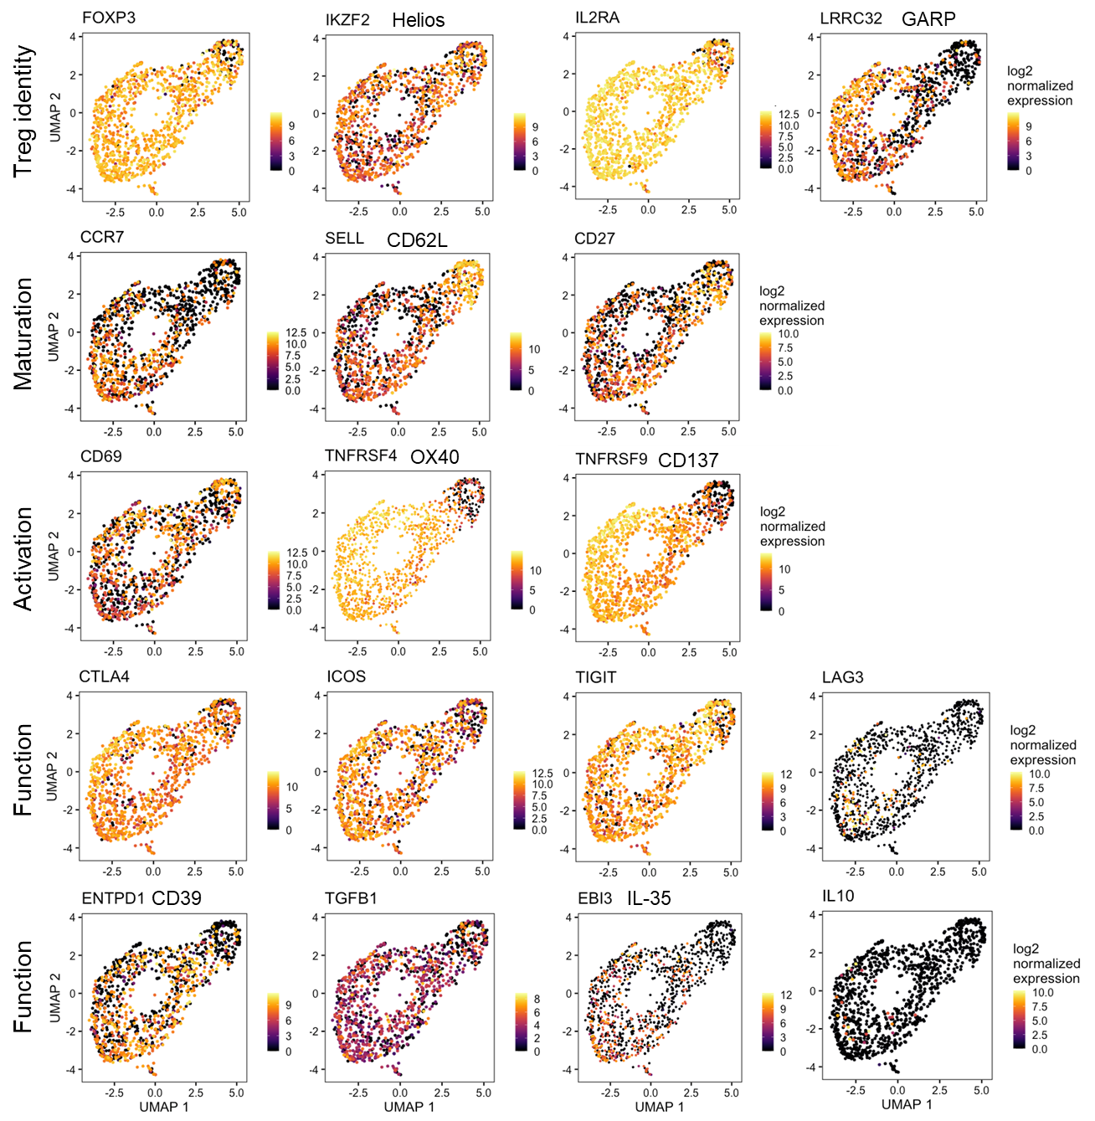
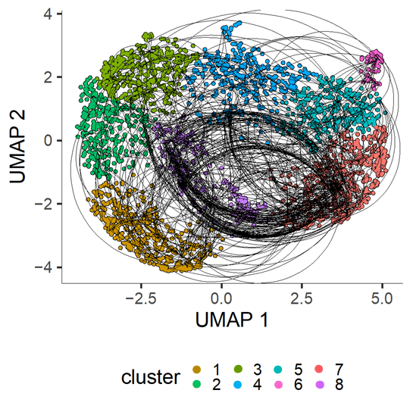
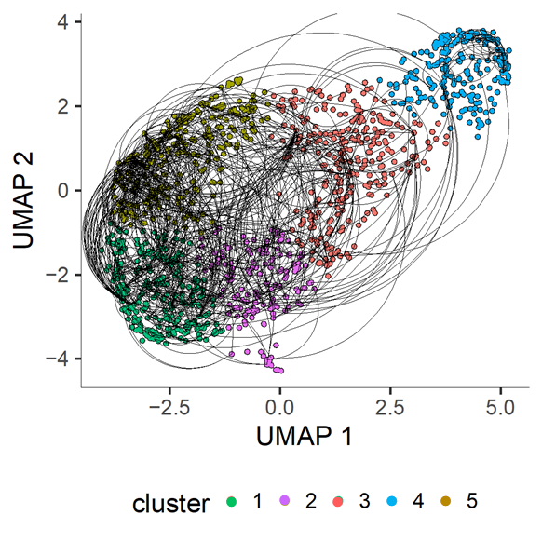
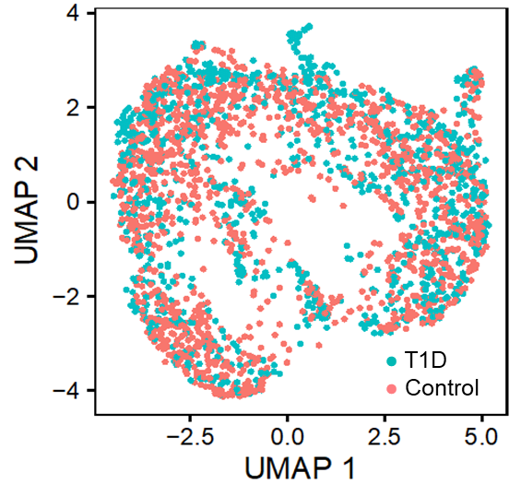
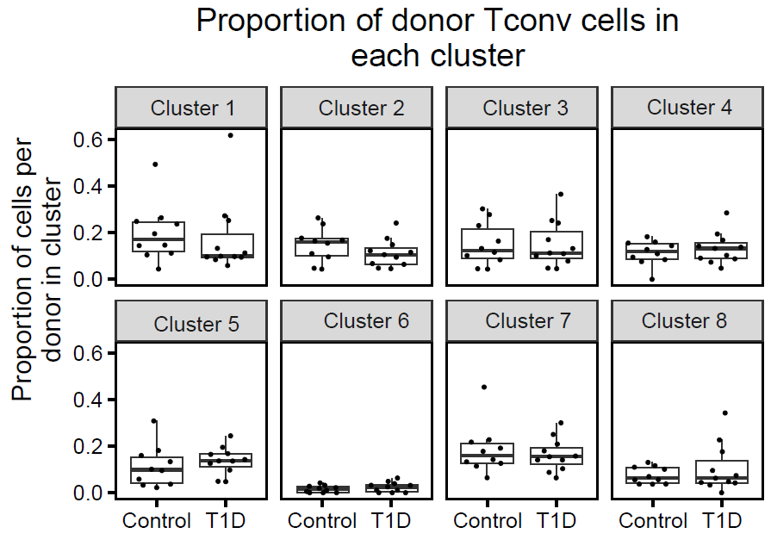
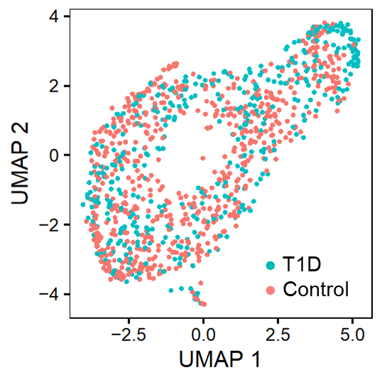
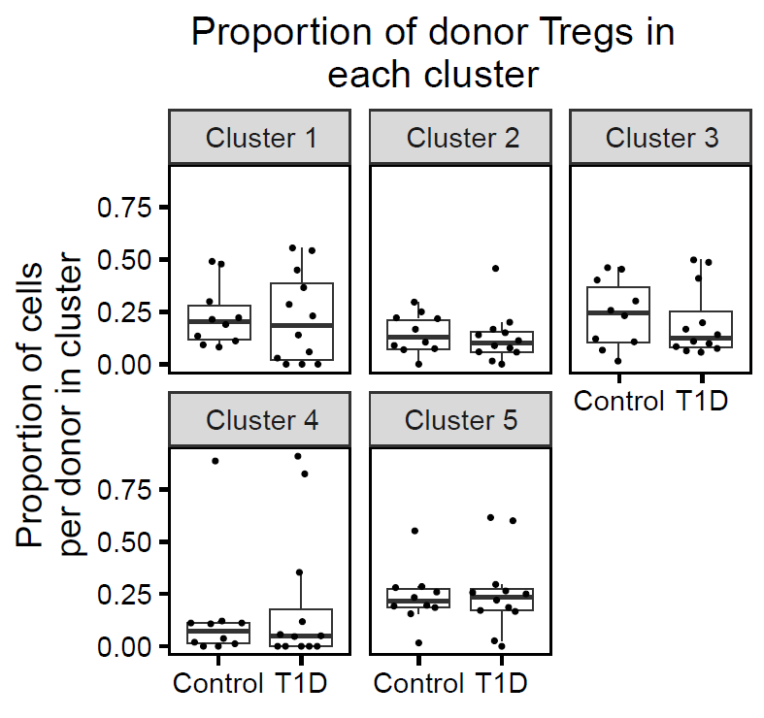

EXPANSION OF ISLET SPECIFIC REGULATORY T cellS in type 1 diabetes
Karen Cerosaletti¹, Janice Chen¹, Alex Hu¹, Soo Jung Yang¹, Emma Mortensen¹, Aleah DeSchmidt¹, Peter S. Linsley¹ Cate Speake¹, David J. Rawlings², and Jane H. Buckner¹
¹Benaroya Research Institute, Seattle WA; ²Seattle Children Research Institute
Summary
Objective:
Characterize the features of islet autoreactive CD4 regulatory T cells (Tregs) in type 1 diabetes (T1D) compared to islet CD4 conventional T cells (Tconv)
Approach:
Peripheral blood from cross sectional cohorts of established T1D subjects and matched non-diabetic healthy controls carrying the high-risk class II DRB1*0401 allele.
Isolated islet reactive CD4 Treg and Tconv cells using a CD154-CD137 activation induced marker (AIM) assay by single cell sorting followed by single cell RNA-sequencing.
Analyzed the frequency, phenotype, and TCR repertoire of islet autoreactive CD4 Tregs and Tconv cells in T1D donors compared with control donors.
Results:
The frequency of islet autoreactive CD4 Tconv and Treg cells did not differ between T1D and control donors, however, islet autoreactive CD4 Tconv cells were significantly more frequent than Treg cells in T1D donors but not control subjects.
Islet reactive CD4 Treg cells had a Treg gene expression profile that differed from Tconv cells, but no differences were detected in transcript profiles of islet reactive Treg or Tconv cells between T1D donors and control subjects.
Islet autoreactive CD4 Treg were expanded and shared TCRs between donors; Tregs had more expanded TCR junctions per donor than Tconv cells.
Conclusion:
Islet autoreactive CD4 Tregs are less frequent than islet Tconv cells in T1D donors and are expanded consistent with antigen experience in vivo.
A. Study donors
Approach
Group | No. subjects | M:F | Age (median, range) | Disease duration (median, range) | HLA class II
T1D | 11 | 2 : 9 | 37y (30-69) | 12.5y (7.4-52.4) | DRB1*0401
Control | 10 | 2 : 8 | 36.5y (26-78) | -- | DRB1*0401
B. CD154-CD137 AIM assay
Simulation | Proteins | No. peptides
DMSO | -- | --
Islet library pool* | IGRP, GAD65 ZnT8, PPI | 183
CEFX† | Microbial pool | 173
1. Islet autoreactive CD4 Tconv cells are more frequent than Tregs in T1D
*20aa peptides, with 12 aa overlap
†15 aa peptides from human bacterial and viral pathogens
The frequency of islet autoreactive Tconv and Treg cells does not differ between healthy controls and T1D donors.
The frequency of islet autoreactive T conventional cells is significantly higher than regulatory T cells in T1D donors but not controls and not for foreign ag reactive T cells.
Created with BioRender.com
C. Single cell sequencing pipeline
2. Islet autoreactive CD4 Treg cells are enriched for Treg signature genes
Ag
Record surface expression to deconvolute specificity
Treg/Th transcript
signature
Differentially expressed genes between islet autoreactive CD4 Tregs cells vs. Tconv cells are enriched in Treg signature genes.
Single cell RNA-seq profiles for islet autoreactive Tregs cluster separately from Tconv cells in a UMAP projection.
4. Islet autoreactive CD4 Treg are expanded and share TCRs between donors
Circos plots showing expansion of islet reactive Tconv and Treg cells within donors and sharing of TCR chains between donors.
Islet autoreactive Tconv and Tregs are expanded within donors consistent with in vivo ag experience.
Tconv and Treg share TRA chains between donors.
Few TCR chains are shared between Tconv and Tregs.
TRA chains
TRB chains
Number of islet auto-reactive T cells by group.
Group | #Tconv | #Treg
T1D | 1,055 | 434
Control | 1,513 | 668
126 of 3796 cells were removed because they misclustered based on flow sorting cell type or because they had an iNKT or MAIT TCR.
3. Islet autoreactive CD4 Tconv and Treg cells do not differ transcriptionally between T1D and control donors
Circos plots depict TCR chain sharing from all Treg and Tconv cells. The outer ring shows cell type, the middle ring represents group, and the inner ring is colored by TCR sequence. Lines connect individual cells sharing TCR chains. Sharing was defined as identical nucleotide sequence of TRA and TRB chains.
Monocle 3 pseudotime trajectories of islet autoreactive CD4 Tconv and Treg cells. The trajectories are annotated based on marker gene expression.
Tregs have more expanded TCR junctions per donor than Tconv cells but there is no significant difference in expansion between T1D vs control donors for either cell type.
Islet Tconv cells
Islet Treg cells
Proportion of expanded CDR3 aa sequences per donor by cell type
Diversity of CDR3 aa sequences per donor
TRA
TRB
150
p-value: 0.0132
p-value: 0.0169
● T1D
● Control
100
● T1D
● Control
Inverse Simpson’s
diversity
50
0
Tconv
Treg
CD4 Type
Tconv
Treg
Analysis was performed by down sampling to equivalent numbers of Tconv and Treg cells. Down sampling was performed 100 times to assess significance.
5. TCR chains are shared between islet autoreactive Tconv and Treg cells with different phenotypes
Monocle 3 pseudotime trajectories are shown for islet reactive Tconv (left) and Treg cells (right). Cells sharing TCR chains (full nucleotide sequence) are connected by lines
Tconv
Treg
The distribution of control and T1D islet autoreactive Tconv and Treg cells doesn’t differ by cluster and no significant differentially expressed genes were identified between groups for either cell type.
Islet Tconv cells
Islet Treg cells
Acknowledgements:
BRI Center for Interventional Immunology
BRI Genomics Core Laboratory
Center for Systems Immunology
Kim Varner | Heather White | Jodie Stroud | David Lee | Kassidy Benoscek Sandra Lord MD | Cate Speake PhD
Kimberly O’Brien | Quynh-Anh Nguyen Jeffry Yaplee | Vivian Gersuk PhD

